Slide 1
Designing Secure Artificial Intelligence Applications
Buck Woody
Applied Data Scientist, Microsoft
Andrew Marshal
Principal Security Program Manager, Microsoft
Notes:
Research and Credits:

Slide 2
Team Data Science Process
The Team Data Science Process provides a standardized description of the tasks involved in a compressive Advanced Analytics project, with defined activities, roles and responsibilities. These can form the basis of a threat matrix design
Phase One
Phase Two
Phase Three
Phase Four
Phase Five
Business Understanding
Data Acquisition and Understanding
Modeling
Deployment
Customer Acceptance
aka.ms/tdsp
Notes:
* Graphic of the process: https://docs.microsoft.com/en-us/azure/machine-learning/team-data-science-process/media/overview/tdsp-tasks-by-roles.png#lightbox
* Documentation: https://docs.microsoft.com/en-us/azure/machine-learning/team-data-science-process/
* Folds into MLOPS: https://azure.microsoft.com/en-us/services/machine-learning/mlops/

Slide 3
Data Security
Data Security differs from platform to platform, since each has specific endpoints and granularity controls, auditing and other security aspects
Relational Data
Non-Relational Data
Physical environment
Operating system
Engine surface
Data objects
Access
Authentication
Auditing
Encryption
Physical environment
Operating system
Ports and RPC
Authentication
Encryption
Logging
Notes:
* RDBMS Security Concepts: https://docs.microsoft.com/en-us/sql/relational-databases/security/securing-sql-server?view=sql-server-ver15

Slide 4
Secure Software Development
Secure Software Development involves a general set of steps to educate your team on the principles involved in considering all threats in a software project
The Trustworthy Computing Security Development Lifecycle
Stage 0: Education and Awareness
Stage 1: Project Inception
Stage 2: Define and Follow Design Best Practices
Stage 3: Product Risk Assessment
Stage 4: Risk Analysis
Stage 5: Creating Security Documents, Tools, and Best Practices for Customers
Stage 6: Secure Coding Policies
Stage 7: Secure Testing Policies
Stage 8: The Security Push
Stage 9: The Final Security Review
Stage 10: Security Response Planning
Stage 11: Product Release
Stage 12: Security Response Execution
Notes:
* Secure Software Development Lifecycle: https://www.us-cert.gov/bsi/articles/knowledge/sdlc-process/secure-software-development-life-cycle-processes

Slide 5
AI Development Cycle Threat Analysis
AI projects involve not only data and software security considerations, but include a pipeline, platform and personnel along with other unique threats to model operation
AI Project Security Aspects
Resilience and Discretion concepts
Authentication
Separation of Duties
Input Validation
Denial of Service mitigation
Bias Recognition
“Black Swan” event detection
Innate forensic capabilities
Notes:
Primary Documentation: https://docs.microsoft.com/en-us/security/engineering/securing-artificial-intelligence-machine-learning
* Black Swan data: https://docs.microsoft.com/en-us/security/engineering/securing-artificial-intelligence-machine-learning#machine-learning-algorithms-must-be-capable-of-discerning-maliciously-introduced-data-from-benign-black-swan-events

Slide 6

Threat Analysis
SQL Server Big Data Cluster
API
API
TDS
Spark
API
SQL Server
SQL Server
SQL Server
SQL Server
HDFS
Controller
Primary Instance
API
Compute Pool
Data Pool
Storage Pool
App Pool
Kubernetes

Slide 7
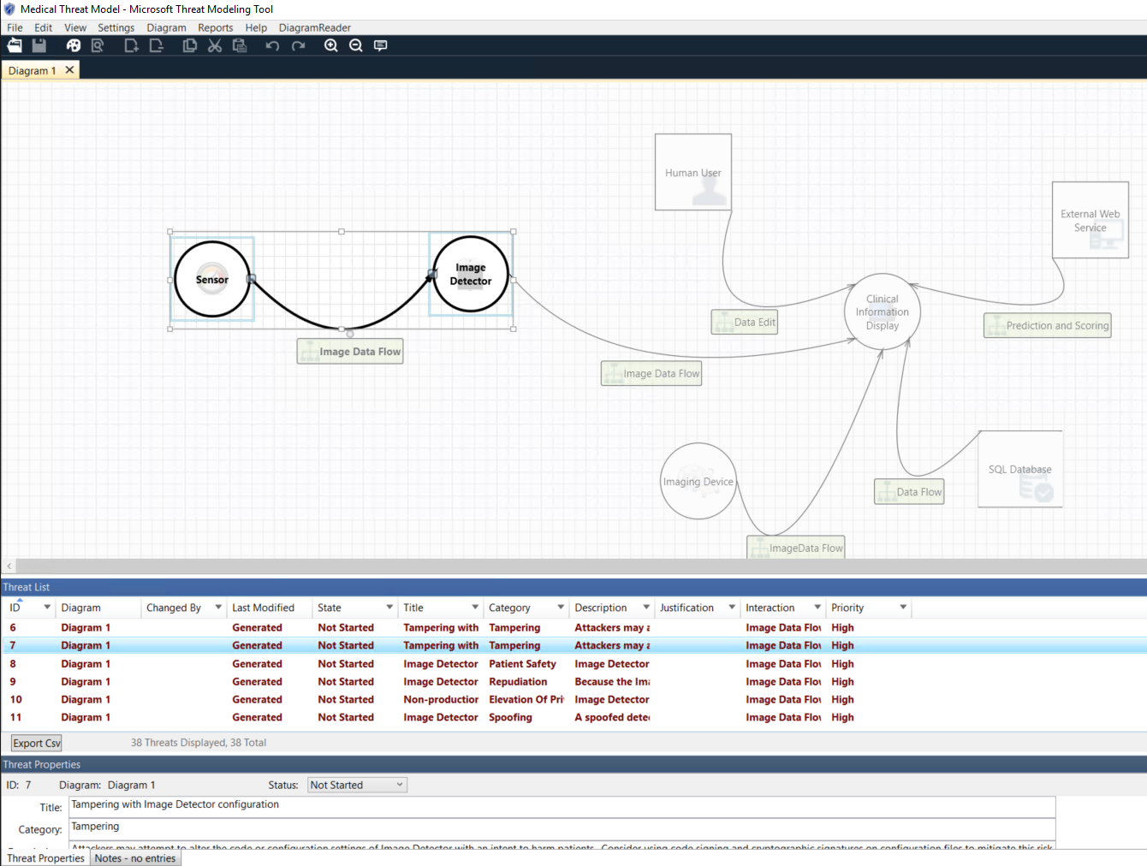
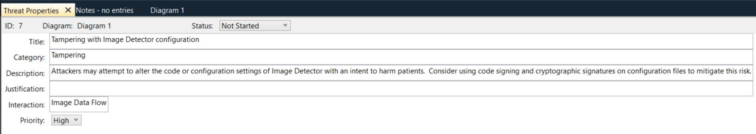
Threat Modeling an AI Application
Notes:
* Threat Modeling Tool Report (open in docs)
* Microsoft Threat Modeling Tool: https://docs.microsoft.com/en-us/azure/security/develop/threat-modeling-tool

Slide 8
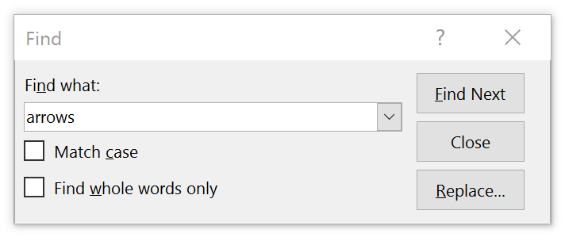
Topic
Emphasis Text Regular Text.
01
Thing
02
Thing

Slide 9
Designing Secure Artificial Intelligence Applications – Deep Dive
Andrew Marshal
Principal Security Program Manager, Microsoft
Notes:
Research and Credits:

Slide 10

Disclaimer/Level Set
Not a Threat Intelligence Talk
No mention of Autonomous Persistent Threats ;-)
Focus on securing AI/ML-based products & services

Slide 11






Customer Compromise via Adversarial ML – Case Study
Training Data ingested from Trusted Providers over Secure Connections
Notes:
Multiple data sources are aggregated from different sources, all over secure channels. Each source has varying levels of trustworthiness and infosec capabilities.
Processing occurs at a data ingestion point prior to the model being generated. At this point the ML model owners are taking custody of the data.
The aggregated data feed is now consumed by code to create the ML Model.
The generated ML model makes algo-based decisions on Oil Futures trades, and forecasts high-ROI sites to bid on for drilling rights
Adversarial data in this pipeline results in bad trades (lost $MM) and drilling in places with no oil (even more lost $MM)
Manipulating the input is a more sophisticated attack not only because it’s more powerful — but also because it has a more realistic threat model behind it. Think about a scenario where an AV (anti-virus) product sits on multiple endpoints and continuously collects data for future re-training. It’s easy for the adversary to insert any files they like — but they have no control over the labelling process, which is done either automatically or manually by a human on the other end. Thus if they’re able to insert benign-looking malicious files, they’ve just installed a backdoor.

Slide 12



Customer Compromise via Adversarial ML – Case Study
Models inform drilling rights purchases and futures trades
Notes:
Multiple data sources are aggregated from different sources, all over secure channels. Each source has varying levels of trustworthiness and infosec capabilities.
Processing occurs at a data ingestion point prior to the model being generated. At this point the ML model owners are taking custody of the data.
The aggregated data feed is now consumed by code to create the ML Model.
The generated ML model makes algo-based decisions on Oil Futures trades, and forecasts high-ROI sites to bid on for drilling rights
Adversarial data in this pipeline results in bad trades (lost $MM) and drilling in places with no oil (even more lost $MM)
Manipulating the input is a more sophisticated attack not only because it’s more powerful — but also because it has a more realistic threat model behind it. Think about a scenario where an AV (anti-virus) product sits on multiple endpoints and continuously collects data for future re-training. It’s easy for the adversary to insert any files they like — but they have no control over the labelling process, which is done either automatically or manually by a human on the other end. Thus if they’re able to insert benign-looking malicious files, they’ve just installed a backdoor.

Slide 13

Customer Compromise via Adversarial ML – Case Study
One provider compromised. No ability to detect data feed tampering
Notes:
Multiple data sources are aggregated from different sources, all over secure channels. Each source has varying levels of trustworthiness and infosec capabilities.
Processing occurs at a data ingestion point prior to the model being generated. At this point the ML model owners are taking custody of the data.
The aggregated data feed is now consumed by code to create the ML Model.
The generated ML model makes algo-based decisions on Oil Futures trades, and forecasts high-ROI sites to bid on for drilling rights
Adversarial data in this pipeline results in bad trades (lost $MM) and drilling in places with no oil (even more lost $MM)
Manipulating the input is a more sophisticated attack not only because it’s more powerful — but also because it has a more realistic threat model behind it. Think about a scenario where an AV (anti-virus) product sits on multiple endpoints and continuously collects data for future re-training. It’s easy for the adversary to insert any files they like — but they have no control over the labelling process, which is done either automatically or manually by a human on the other end. Thus if they’re able to insert benign-looking malicious files, they’ve just installed a backdoor.

Slide 14
Customer Compromise via Adversarial ML – Case Study
Malicious data ingested, trusted blindly
Notes:
Multiple data sources are aggregated from different sources, all over secure channels. Each source has varying levels of trustworthiness and infosec capabilities.
Processing occurs at a data ingestion point prior to the model being generated. At this point the ML model owners are taking custody of the data.
The aggregated data feed is now consumed by code to create the ML Model.
The generated ML model makes algo-based decisions on Oil Futures trades, and forecasts high-ROI sites to bid on for drilling rights
Adversarial data in this pipeline results in bad trades (lost $MM) and drilling in places with no oil (even more lost $MM)
Manipulating the input is a more sophisticated attack not only because it’s more powerful — but also because it has a more realistic threat model behind it. Think about a scenario where an AV (anti-virus) product sits on multiple endpoints and continuously collects data for future re-training. It’s easy for the adversary to insert any files they like — but they have no control over the labelling process, which is done either automatically or manually by a human on the other end. Thus if they’re able to insert benign-looking malicious files, they’ve just installed a backdoor.

Slide 15
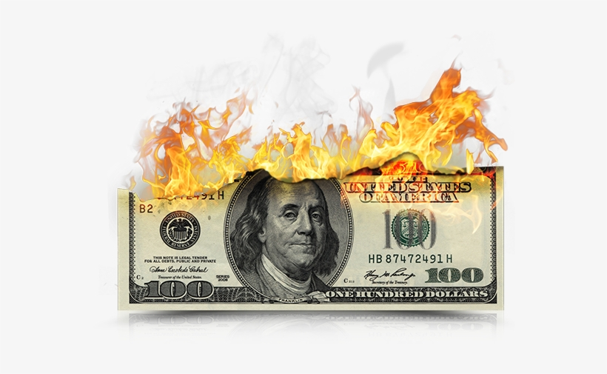

Customer Compromise via Adversarial ML – Case Study
Model outputs tainted, discovered too late
Notes:
Multiple data sources are aggregated from different sources, all over secure channels. Each source has varying levels of trustworthiness and infosec capabilities.
Processing occurs at a data ingestion point prior to the model being generated. At this point the ML model owners are taking custody of the data.
The aggregated data feed is now consumed by code to create the ML Model.
The generated ML model makes algo-based decisions on Oil Futures trades, and forecasts high-ROI sites to bid on for drilling rights
Adversarial data in this pipeline results in bad trades (lost $MM) and drilling in places with no oil (even more lost $MM)
Manipulating the input is a more sophisticated attack not only because it’s more powerful — but also because it has a more realistic threat model behind it. Think about a scenario where an AV (anti-virus) product sits on multiple endpoints and continuously collects data for future re-training. It’s easy for the adversary to insert any files they like — but they have no control over the labelling process, which is done either automatically or manually by a human on the other end. Thus if they’re able to insert benign-looking malicious files, they’ve just installed a backdoor.

Slide 16
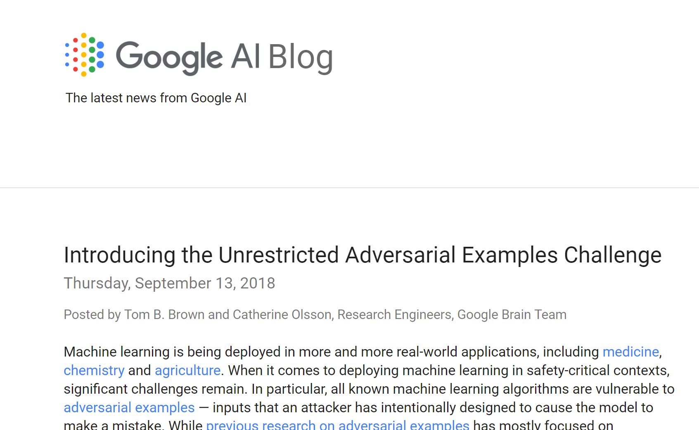
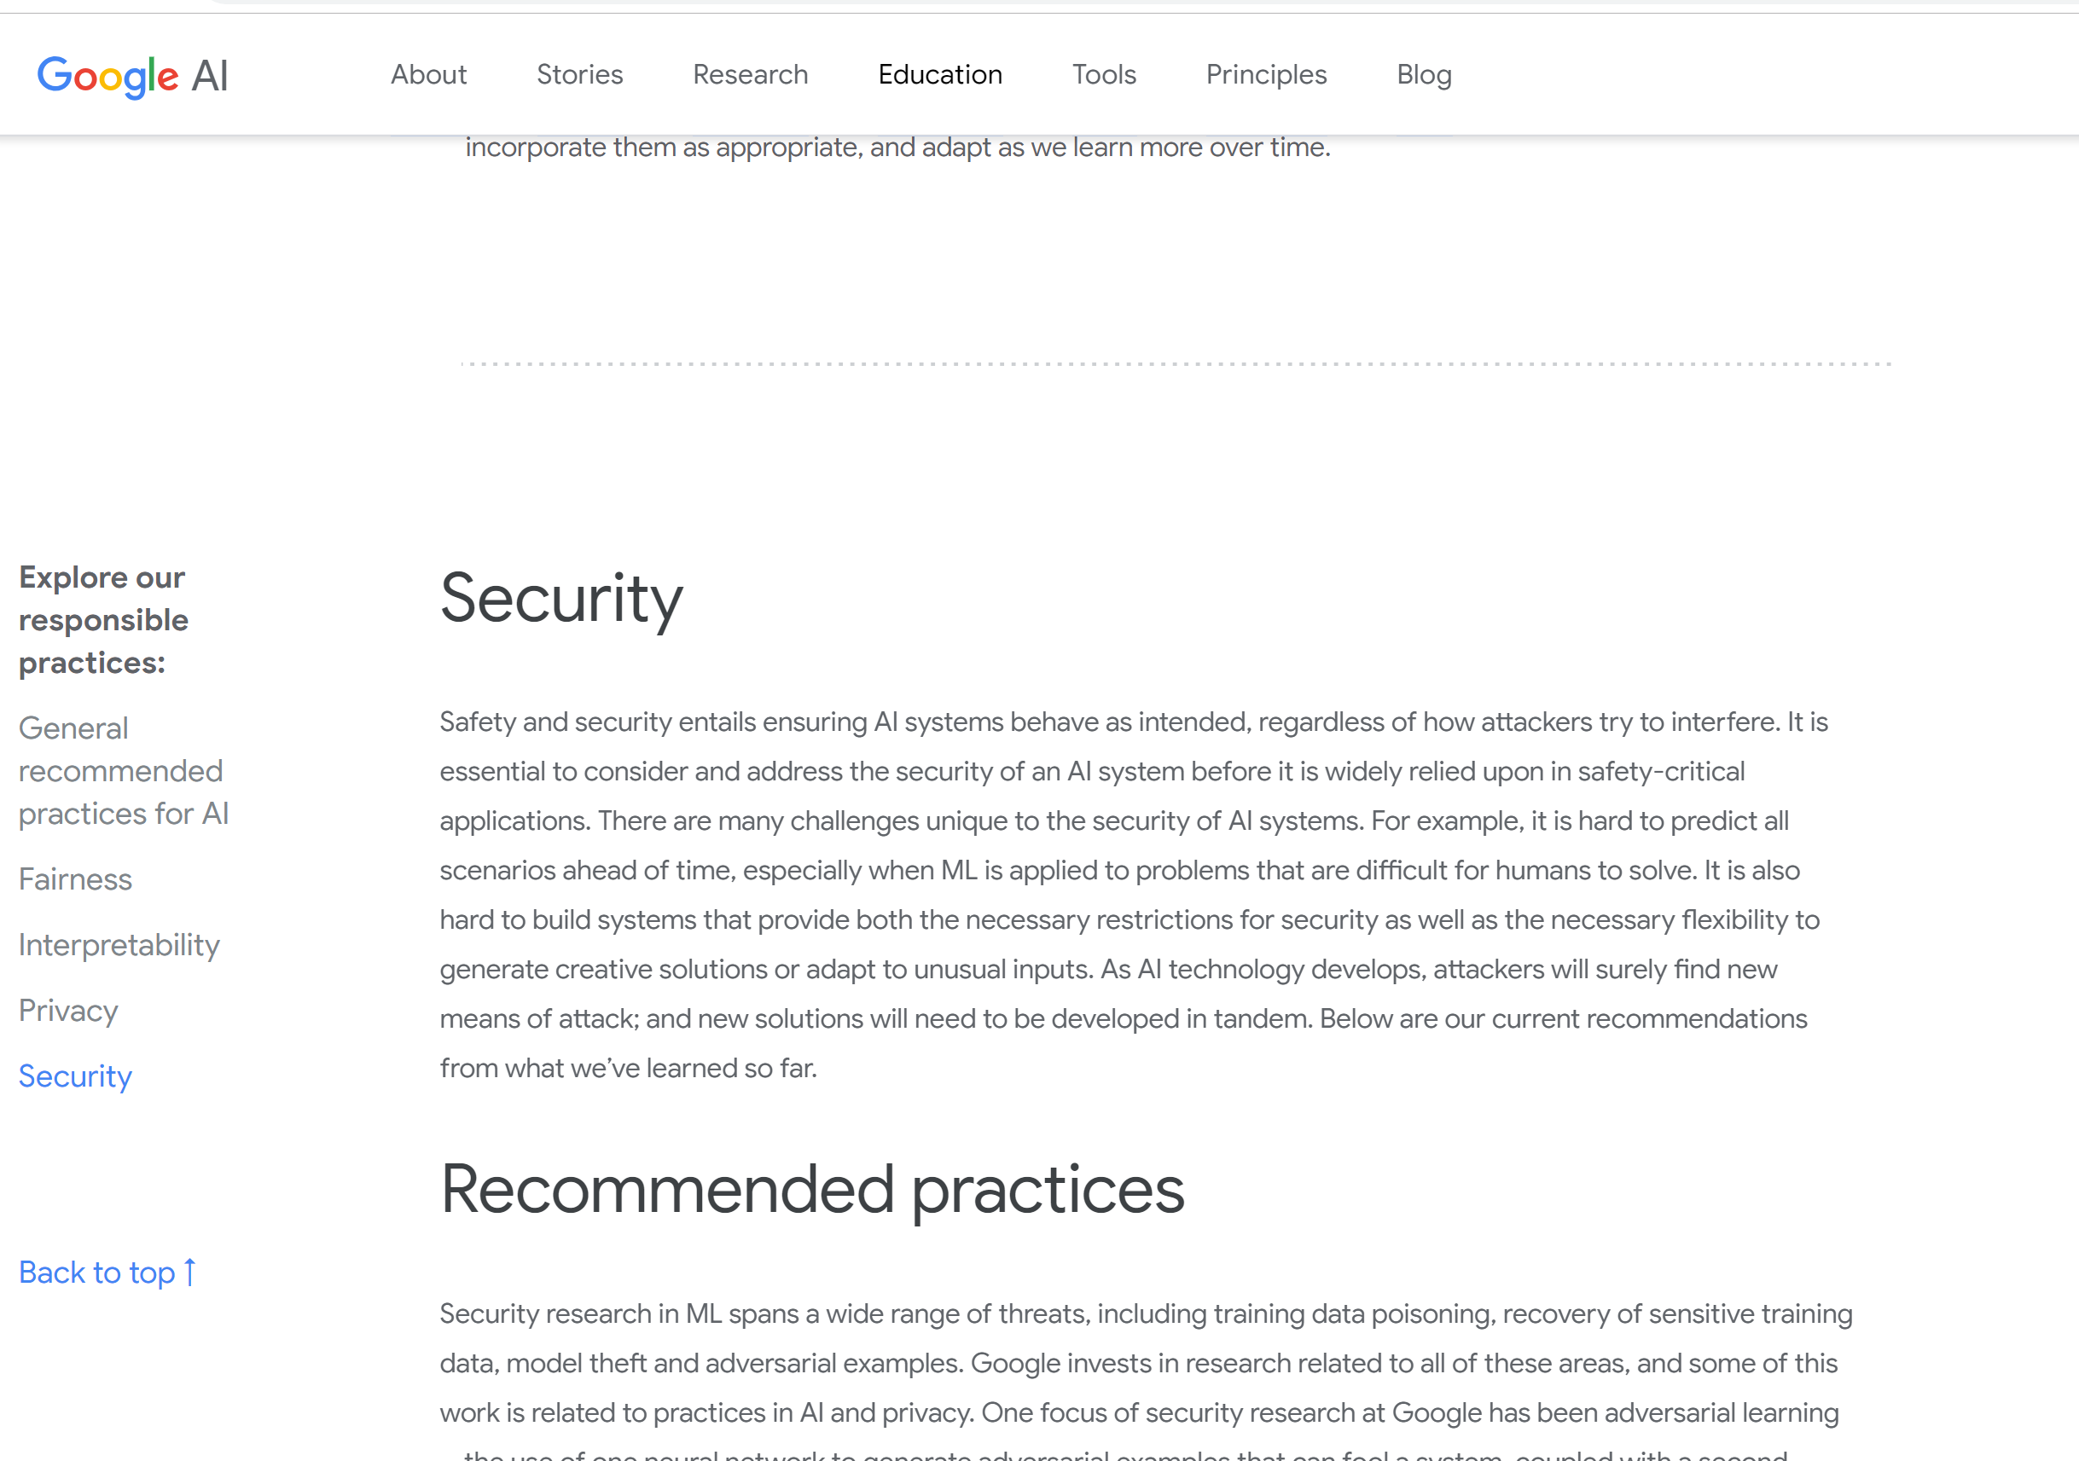
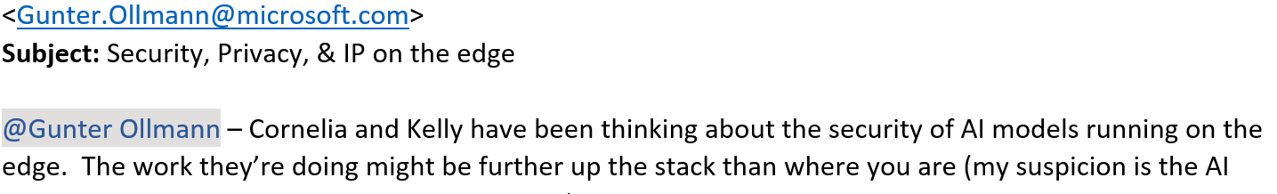
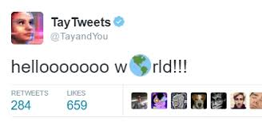
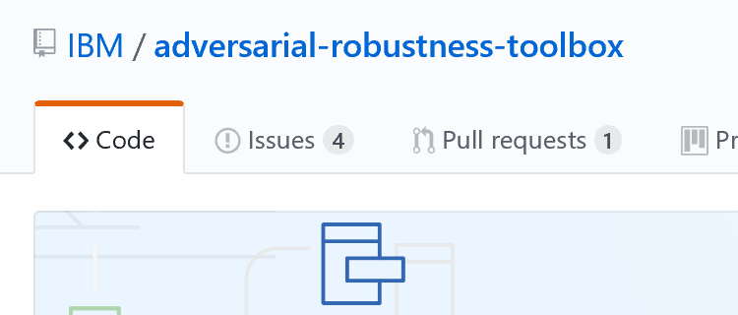
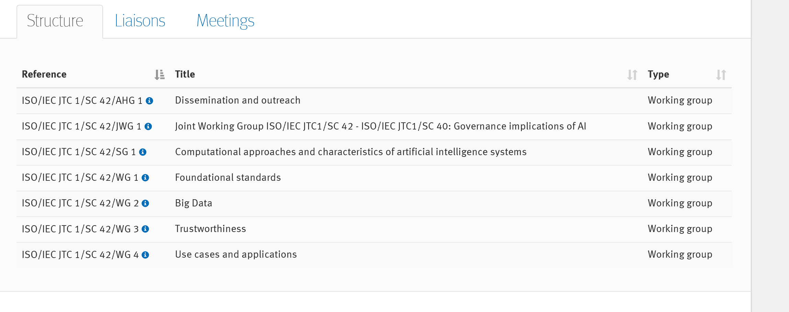
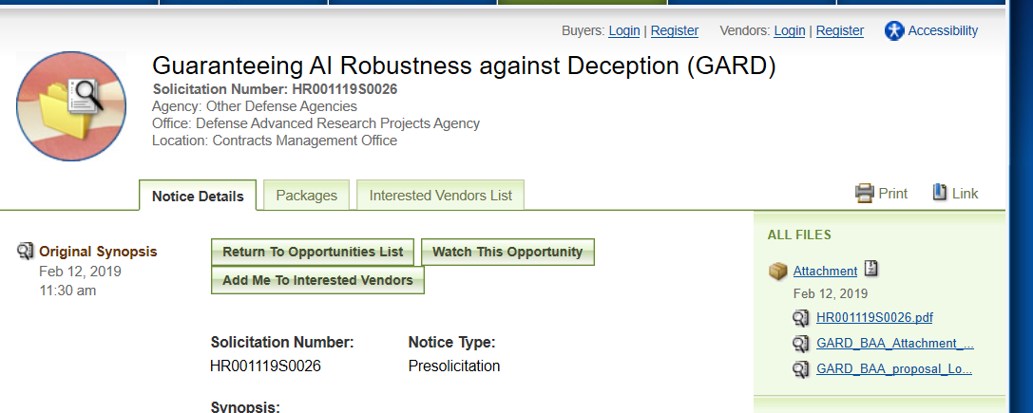
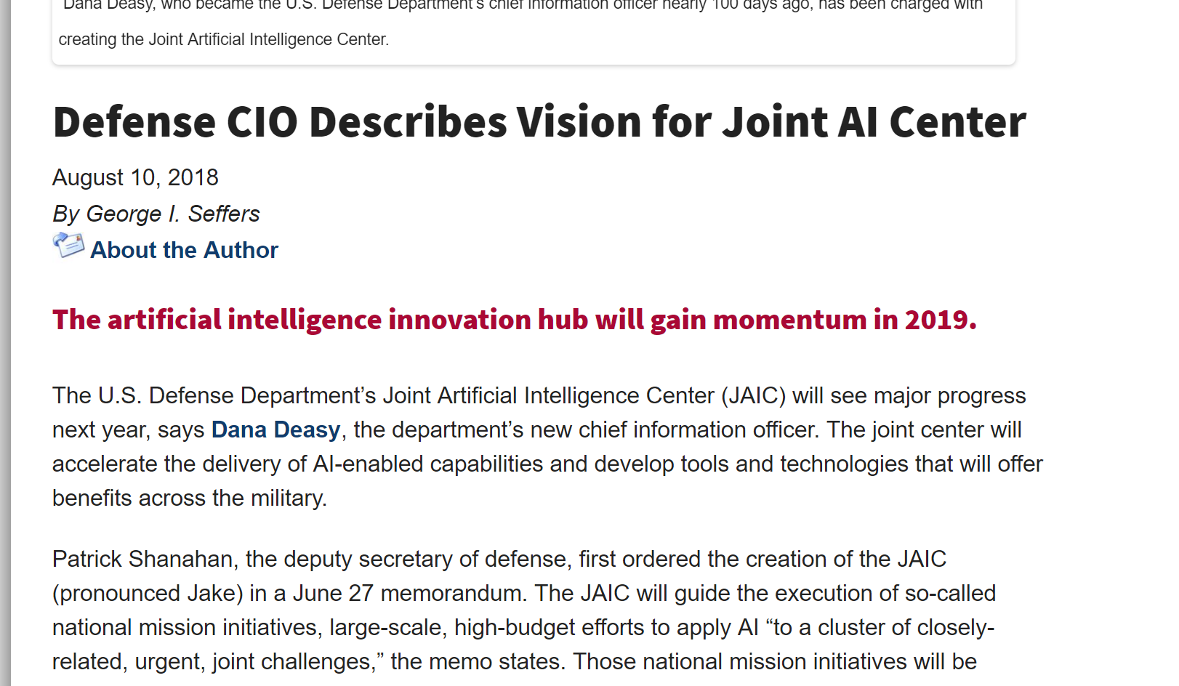
Pivoting from Research PoCs to Weaponized Exploitation
MSRC Case 45516, reported by a researcher from Salesforce, showed text-to-speech attacks on Cognitive Services speaker recognition, where an attacker uses text-to-speech to mimic the original speaker voice.

Slide 17
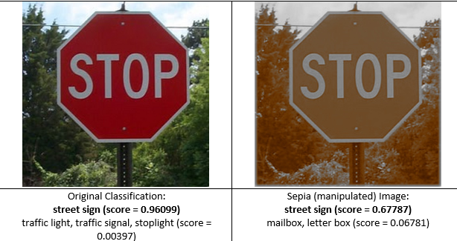
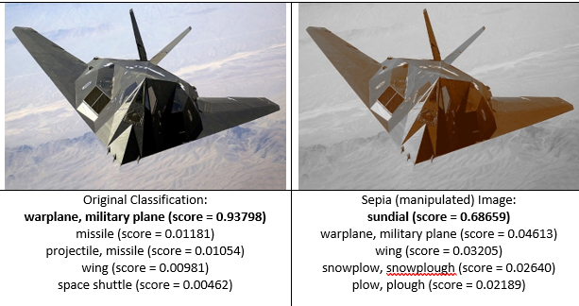
Higher Order Bias/Fairness, Physical Safety & Reliability concerns stem from unmitigated Security and Privacy Threats

Slide 18


Failure Modes in Machine Learning
Establishes common vocabulary across industry and academic partners for these net-new threats
Details both intentional and unintentional failure modes
This is our lens for Threat Modeling & Bug Triage Guidance

Slide 19
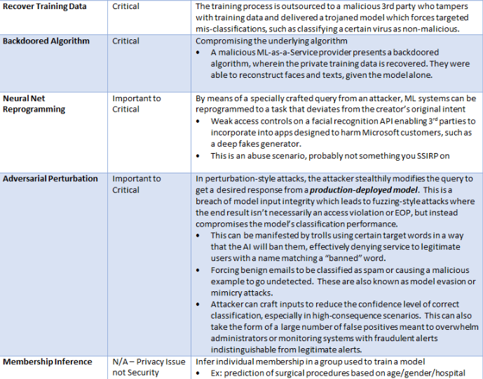
Adversarial Attack Classification
Model development
Model deployment
Data Poisoning
Model Stealing
Model Inversion
Physical Domain
Attack ML Supply Chain
Recover Training Data
Backdoored Algorithm
Neural Net Reprogramming
Adversarial Perturbation
Membership Inference

Slide 20

Threat Modeling AI/ML Systems and Dependencies
Holistic view of today’s threat landscape
Built into existing SDL security review process
Threat enumeration & detections/mitigations where available
Provides Security Engineers with structure for deep dives, vuln triage
Provides Data Scientists with actionable threat mitigation specifics

Slide 21

AI/ML Pivots to the SDL Bug Bar
Provides triage guidance for incident response
Examples/business impact & traditional vuln equivalents
All content on https://docs.microsoft.com/security/engineering/

Slide 22

The Evolution of AI/ML Security Guidance at Microsoft
Gap Analysis and Awareness
Recommendations
Tooling Proof of Concept
Engineering Group Onboarding
Monitoring/Analysis/Value-Prop
Automation-focused Requirements
External Standards
We are here
And Here
Notes:
Discuss not just what we’ve landed/where we are as a company, but also what you can expect from us in the future and what it takes to get there. Also explain how we’re not reinventing the SDL from the ground up for AI, but instead integrating directly into existing security review processes.

